Slide 1

Week5 Project 1
COMP90007 Internet Technology
Prepared by: Chenyang Lu (Luke)

Slide 2
Overview of the project
10% of final mark
Measuring number of hops. bandwidth, delay, and jitter
Report should follow format guide provided in LMS

Slide 3
Before get started
Using lab PC is recommended (all software has been pre-installed)
Or you can access digital server to do the experiment, the guidance of accessing remote Unix server is provided at the end of the slides.
Or you can do the experiment under your local computer environment, but I can only provide very limited help. (Less recommended)

Slide 4
Section 2: Measuring the hop counts

Slide 5
Section2 Measuring the hop count
Object:
Observing the number of intermediate hosts (hops) in the route taken to communicate with remote server.
Utility tool:
Traceroute
Command line:
OSX/Linux: traceroute –nw l cis.unimelb.edu.au
Windows: tracert –d –w l cis.unimelb.edu.au
Main interest:
Number of hops it takes to reach the destination server
Help documentation for traceroute utility:
OSX: man traceroute
Windows: tracert /?
  c

Slide 6
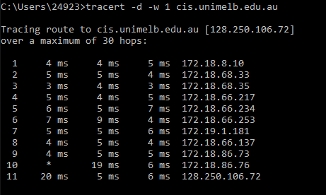
Section2 Results analysis
Do not resolve
address to host name
Time out 1 s
utility
hostname
Hops count
Ip address of hops go through

Slide 7
Section2 Terminologies
Hops: the computers, routers, or any devices that comes in between the source and the destination.
Hostname: In computer networking, a hostname (domain name) is a label that is assigned to a device connected to a computer network. One hostname can map to several Ip addresses, but not the other way round.
More information about traceroute: https://www.slashroot.in/how-does-traceroute-work-and-examples-using-traceroute-command (not necessary to read, but if you want to get deeper understanding of TTL, ICMP, you could read through that)

Slide 8
Section2 specification
2.1 what does the command –n w 1 (equivalently –d –w 1 on windows) mean?
Hint: Please check the help documentation for traceroute utility
2.2:
1. Plot hop count versus geographical distance from Melbourne (linear regression might help)
2. Explain your rationale with respect to networking concepts
Hint:
Do it as soon as possible, otherwise the public server might not be available before due date
If servers crush, Go to: https://iperf.fr/iperfservers.php and find any other iperf server, you can also deploy you own iperf server.

Slide 9
Section 3: Measuring the Delay and jitter

Slide 10
Section3 Measuring delay and jitter
Object:
Measuring the delay and jitter of different hosts
Method:
ping
Command line:
OSX/Linux: ping –c 3 unimelb.edu.au
Windows: ping unimelb.edu.au
Main interest:
Calculate round trip delay(RTT) and jitter

Slide 11
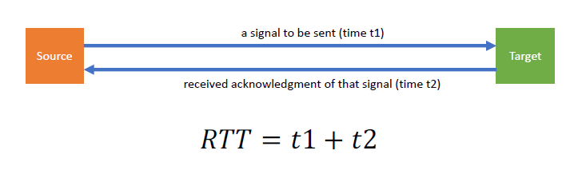
Section3 Continue..
Round Trip Delay:
The total time of one source host to send a packet to the target and wait for its acknowledgement to be received
Jitter:
Jitter is the variation in ‘packet’ delay. In other words, jitter is measuring the time difference in packet inter-arrival time.
Cite from: Yiran Ruan, S2 2019, Workshop5, workshop notes, COMP90007 Internet Technology, University of Melbourne, delivered 27 August, 2019

Slide 12
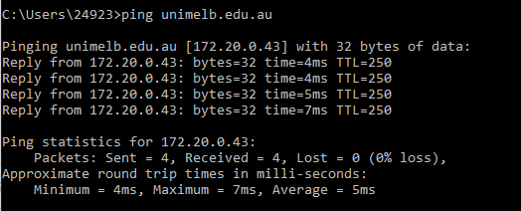
Section2 Results analysis
utility
hostname
RTT delay
Some statistics

Slide 13

Section3 Continue..
Calculate Round Trip Delay:
Calculate the average of the delay
Calculate Jitter:
N: number of data
X: mean of set of data
If there’re no difference between delay
For macOS/Linux:
Use sqrt(((mdev1)^2 + (mdev2)^2 + (mdev3)^2) / 3 )
For windows, download hrPing:
hrping [host address]

Slide 14
Section3 Specification
3.1 Calculate round trip delay (RTT):
Make three delay measurements(run command three times) for each server
Calculate average round-trip delay and jitter
Plot RTT versus the physical geographical distance to the server
3.2 Discuss the plot you get
Explain your result with reference to the network environment
  Upload, download speed
  User sharing the network
  Load network through other apps

Slide 15
Section 4: Measuring the bandwidth-delay product

Slide 16
Section4 Measure the bandwidth*delay
Object:
Measure the bandwidth of different hosts in order to determine the bandwidth-delay product
Method:
iperf (download from http://iperf.fr)
Use client mode (-c)
Command line:
iperf –c [hostname]
Or iperf3 –c [hostname] –p 5002
If possible , try to use iperf instead of iperf3
Main interest:
Calculate product of bandwidth and delay

Slide 17
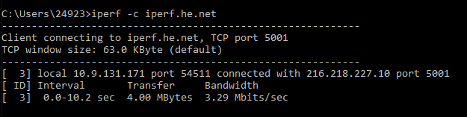
Section4 Results
Client mode
Hostname
utility
Bandwidth
Hint: if you use ‘iperf3’, it will pops two bandwidth: sender and receiver. You should the sender one.

Slide 18
Section4 Specification
4.1 what does the bandwidth-delay product tells us about the networks? Take three measurements for each host.
4.2 Take the mean bandwidth and calculate the bandwidth-delay product in kilobits.
Use average of RTT from ping test as delay time
Plot a bar char for each host as result
Explain result with reference to your network
4.3 plot bandwidth-delay product versus the hop count
Discuss if there’s any correlation
4.4 What factors may affect the accuracy and reliability of your results (bandwidth, delay, jitter)?, How might you improve upon these?

Slide 19
Connect to remote server

Slide 20
Remote server access
Note: If you decide to use Lab PC, then you can skip this section. But if you decide to use your own laptop to do the project, the easiest way is connecting to remote Unix server.
To connect to remote server:
ssh [username]@digitalis.eng.unimelb.edu.au
Or
ssh [username]@digitalis2.eng.unimelb.edu.au

Slide 21
Final words
When you do the tests, remember to screenshot the results. All the results should be placed in appendix, all the plots should be placed in the main body of your result
Work in a consistent networking environment
Submit your report as a PDF file (A4, 10pt font, 1.5 lines-spacing, min 3.8cm left and right margin)
Use format guide document provided in LMS
Maximum 10 page excluding appendix
Information provided in this slides are simplified, please refer to the document provided in LMS for detail requirement

